Slide 1
Customer-Retainment Model and Ideas
By David Jia

Slide 2
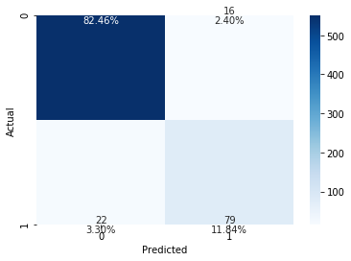
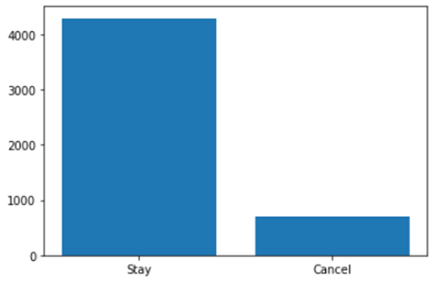
Overall Model Predictions
-Decent predictive qualities
Accuracy:
Precision:
Relatively successful operations, a lot of staying vs. cancel

Slide 3
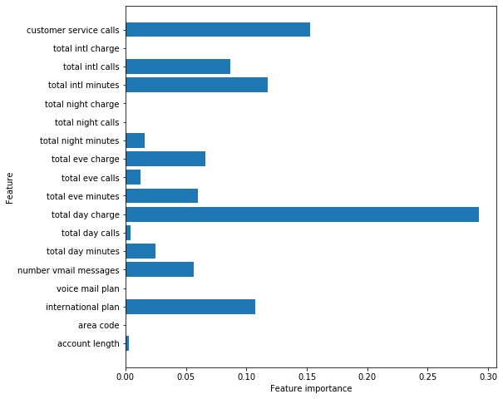
Important Features
Data shows customer service calls equates to customers keeping the service more
Number of customer service calls
International Plan/Voice-Mail Plan
Total charge during day

Slide 4
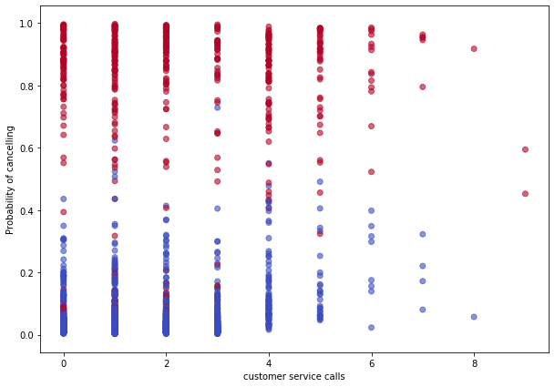
Customer Service:
Shown to have a significant effect on customers canceling or leaving
-the more calls the better
-a lot of cancellations had no calls or one call
Can mean different things:
Customer service does a good job at handling disgruntled clientele
Clientele call once but are continually frustrated and quit
Clients that tend to call have been with the service for a longer time

Slide 5
Customer Satisfaction
Ideas
Increasing customer satisfaction has shown to be important
Possible Ideas to increase:
If customer service team shown to be competent and decreasing cancels, expand that part of the company while weighing cost and benefit
advertise the service line more often and increase the hours
Implement follow-up calls to confirm the issue at hand has been completely solved

Slide 6
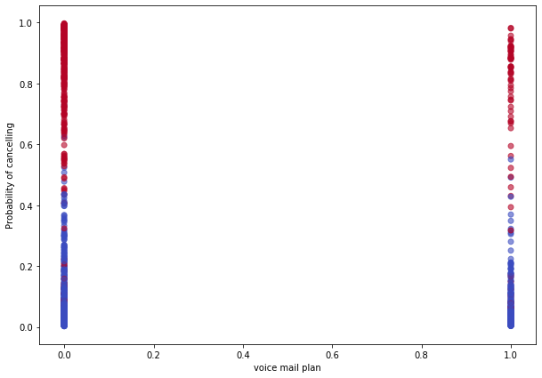
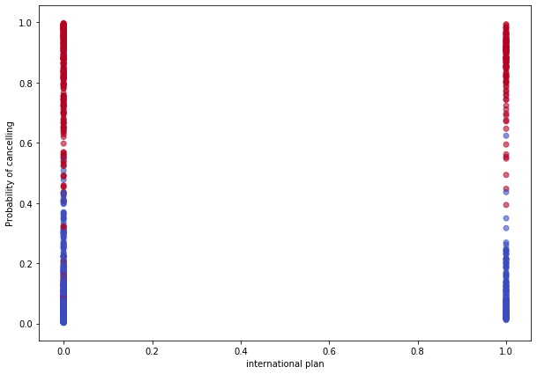
Voice Mail and International Plans
Importance in getting customer on either plan:
-noticeably less cancels
-additive effect of lessening cancels

Slide 7
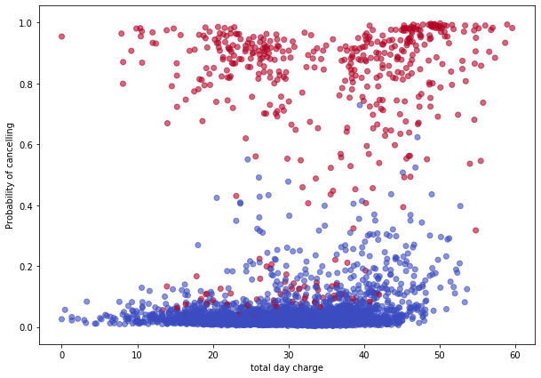
Finding Optimal Pricing
Seems to be a noticeable sweet spot in the pricing model in which customers cancel less
$33-40 per day charge
May be optimal pricing
-high cancels near 50 and above (too expensive)
-high cancels near 30 and below (bad quality)

Slide 8
Promotion Ideas
Up quality of service for those paying $30 dollars and see whether the number staying outweighs the cost of upping quality
Offer those paying $40 or more to decrease their plan cost in exchange for more ads or a longer service period
Give the customer a free phone ($400-800) in exchange for continuing a plan at $40 for two years

Slide 9

Thank You for Listening!

